Slide 1
Resilience Awareness Programme Introduction

Slide 2
context
Since the collapse in oil price in 2014, the whole industry has been undergoing a painful readjustment to the new market environment.
This has affected all companies in the marine contracting sector, resulting in significant down-sizing of businesses onshore and offshore. To the extent that the industry is now considerably smaller than it was during the thriving times of $100/barrel oil.
The impact at a human level has created considerable stress and anxiety, for the obvious reasons of job security, financial hardship, and uncertainty about the future.
Shell recognised that this situation could pose an operational and safety risk to their business and developed a wide-ranging programme for their entire workforce, focussing on developing resilience – mental toughness - in managing these pressures and maintaining focus in the workplace.
The Board Member companies of IMCA have, with the full support of Shell, developed their material into a video format specifically for the marine contracting industry.
The programme comprises six ten minute videos - all made freely available to the industry on IMCA’s website. Other organisations are welcome to use it.

Slide 3
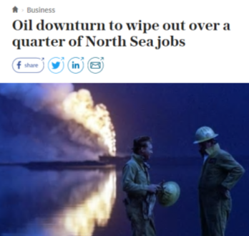
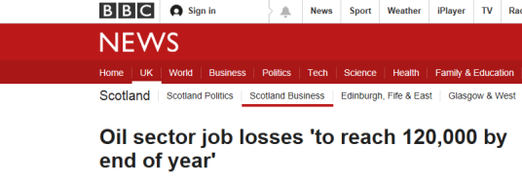
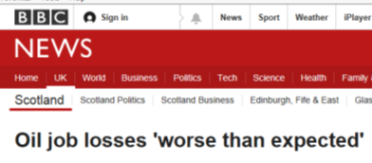
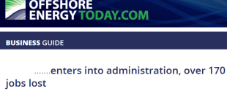
IMPACT OF OIL PRICE COLLAPSE

Slide 4
Why raise resilience awareness now?
It makes good sense for every business to look after the welfare of their personnel and one way is to help build personal resilience.
If we are more resilient we can better cope with life and work.
Resilient organisations are successful organisations.
Resilient organisations are made up of resilient people.
Irrespective of a situation that we need to deal with, being resilient helps us to cope with the pressure.
So whether we are really busy, have a personal issue, or even a financial problem - having good personal resilience helps us through these challenges.
Resilience is a life skill and enables us to better support other people including family, friends and colleagues.

Slide 5
What is resilience?
Resilience is about working through difficult experiences and having the ability to bounce back quickly. Resilience is learning from the way we cope with a difficult or stressful situation and making good use of that learning experience in the future.
Fortunately we all have a level of resilience which we have developed throughout our careers, and there are ways in which we can increase this capability through learning and training.
Developing and hardening our mental resilience through awareness training can help us manage stress; and make clearer, better-quality decisions in stressful situations. We can also bounce back and respond more quickly when things go wrong – much like an athlete in Shell’s analogy, who needs to practice and develop mental strength and toughness, as well as the physical strength and skills to be successful.
The Resilience Awareness Programme of six video modules explains the main concepts of resilience and proposes some useful tips on how we can develop and improve this capability for use at work and at home.

Slide 6
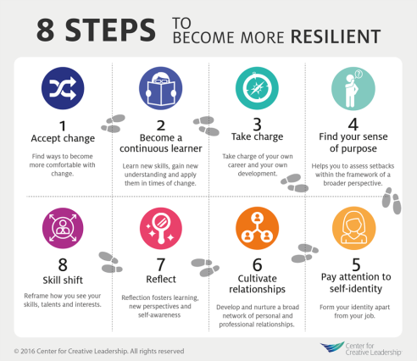
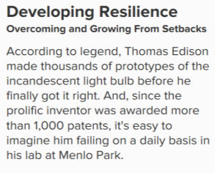
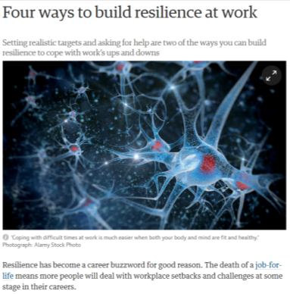
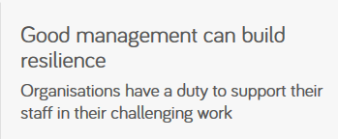
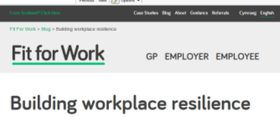
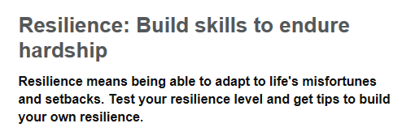
Fighting back

Slide 7
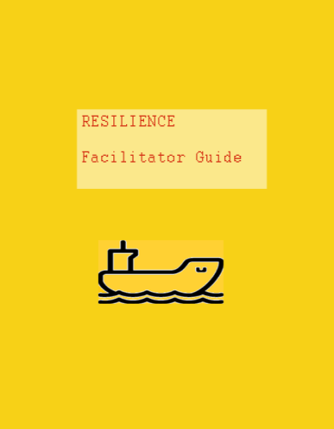
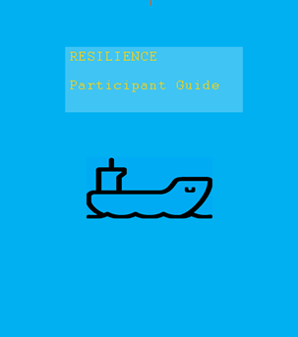
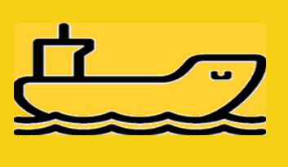
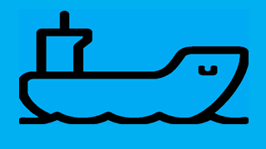
Based on shell’s programme
RESILIENCE
Facilitator Guide
RESILIENCE
Participant Guide

Slide 8
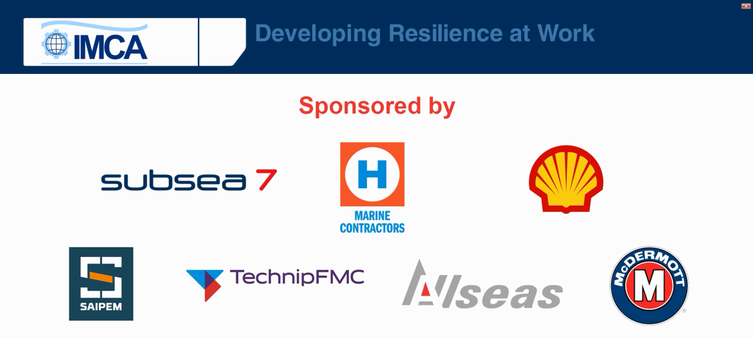
A collaborative development
IMCA would like to thank Heerema Marine Contractors, Saipem and Subsea 7 for the filming this programme on their vessels and worksites.

Slide 9
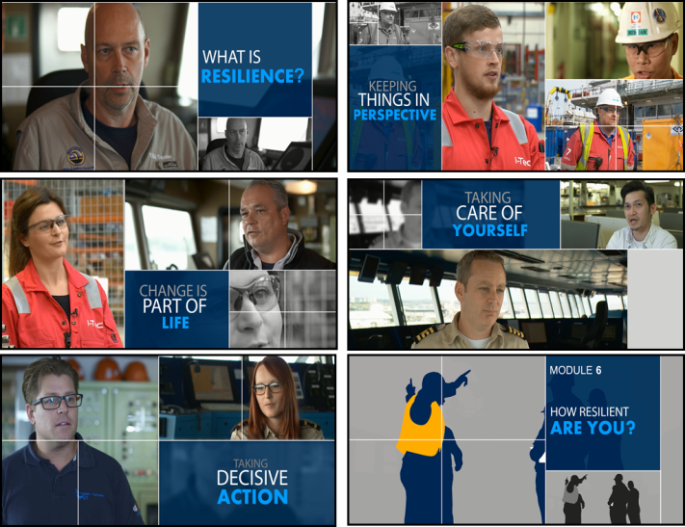
A video based programme in 6 modules
Module 1
Helps us to understand ways we can develop our resilience to help us to stay safe.
Module 2
Helps us make safer decisions by teaching us how to keep things in perspective.
Module 3
Explores how to cope with change and prevent change having a negative impact on safety.
Module 4
Looks at how taking care of ourselves will help us be safer by being more alert and sharper.
Module 5
Looks at keeping ourselves safe by reminding us to always think things through before acting.
Module 6
Summary and recap of the previous modules with some further scenarios to discuss

Slide 10
Who is the resilience programme for?
Everyone at the worksite should work through all six video modules.
Each worksite should schedule sessions to align with the availability of the attendees and viewing facilities.
It is recommended that the video sessions be spaced-out to give time for people to think about their content. This could be over a period of a week or even a month.
The purpose of the videos is to promote discussion, and the groups of attendees should be selected to enable this to happen in a balanced way. For example, if there are significant differences in seniority in the group, this may stifle discussion - which is not the objective.
There is no absolute rule for the mix and number of attendees, and the worksite will select the optimum groups. As a guide, a minimum of 4 people and maximum of 8 has been found to be very effective.
We hope that you manage to get something positive out of the experience.

